Slide 1
Excellence in Precision or
Emerging Overinvestment ?
Dr. Anand Subash
Consultant Head and Neck Surgical Oncologist and Robotic Surgeon
Program Director - Minimally Invasive Head and Neck Surgery
Associate Professor - Head and Neck Surgical Oncology
HCG Hopsitals, Bangalore

Slide 2
“Technology IS IMPORTANT BECAUSE IT CREATES THE FUTURE. WE ARE ABLE TO BE A PART OF THE ‘NEXT’ AND CREATE THINGS THAT DON’T EXIST” – MC HAMMER
“Technology IS A USEFUL SERVANT BUT A DANGEROUS MASTER” – CHRISTIAN LOUS LANGE

Slide 3

INDIA SURGICAL ROBOTICS MARKET
India is one of the fastest-growing markets for surgical robotics, expected to grow from $851 million in 2023 to nearly $4 billion by 2031.
Growing demand for quality healthcare and the absence of matching delivery mechanisms - Opportunity.
India has over 850 robotic assisted trained surgeons and have over 170 da Vinci systems installed

Slide 4

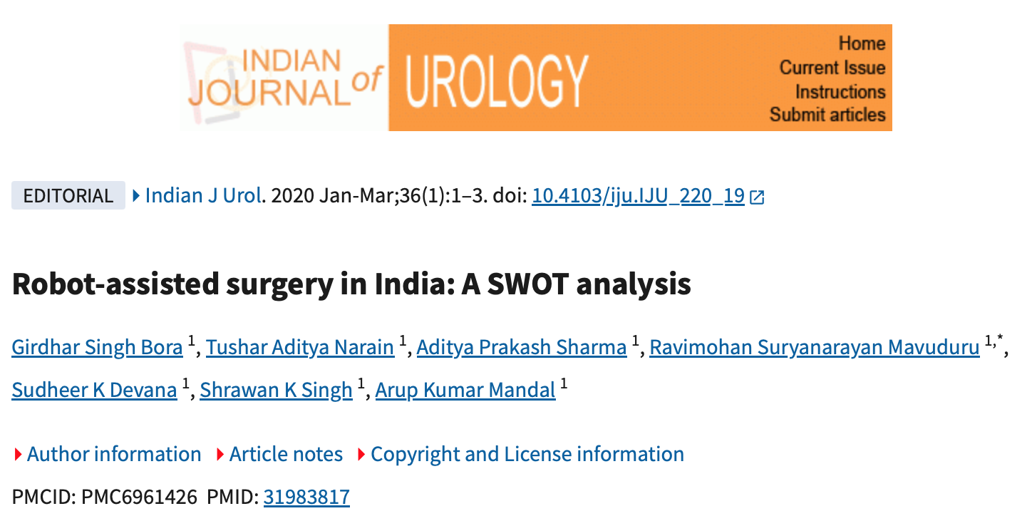
STRENGTH
  Patient Base
  Growing Economy
  Good Surgical Skills
  Increased Insurance Coverage
WEAKNESS
  High Initial Investment
  Recurring Consumable Cost
  True Benefit – Comparison Study

Slide 5
OPPORTUNITY
  Expanding Infrastructure
  Medical Tourism
  Newer Robotic Systems
THREAT
  Fear of Losing Out
  Compromise in Training

Slide 6
Robotic revolution in ent
Over 170 robotic installations
Indications - TORS, Thyroidectomy, Laryngeal Surgery, Sleep Apnea Procedures, Neck Dissections
5-fold increase in the number of surgeons from ENT background

Slide 7


Slide 8
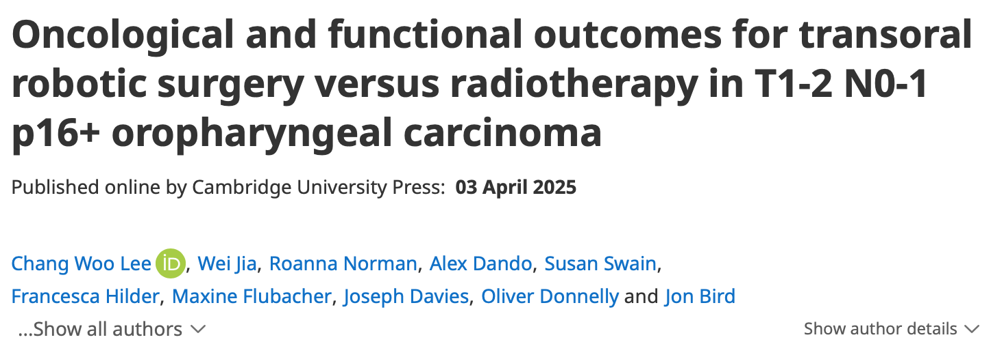
Promise of precision
Better DFS with surgery
Functional outcomes – Similar
  Subgroup Ananlysis – Surgery alone – Superior Results

Slide 9
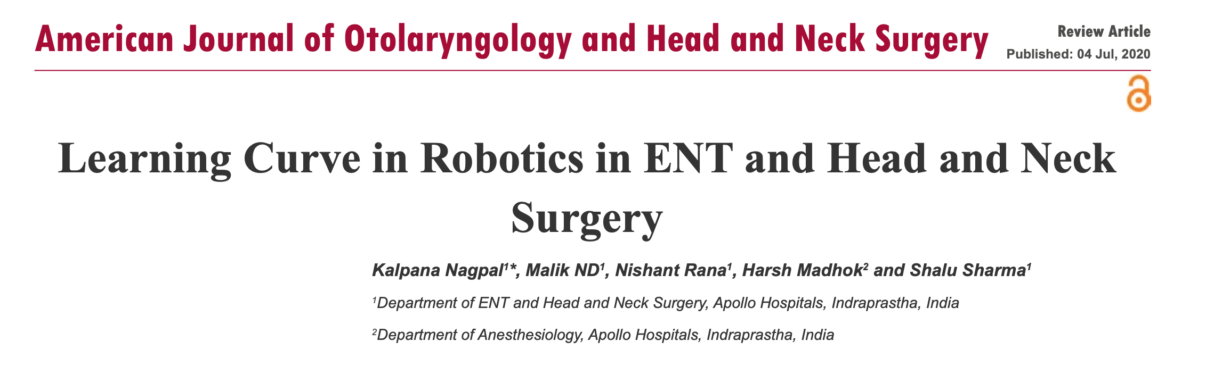
Reality of learning curve
25-30 cases to reach a plateau
Training Investment

Slide 10
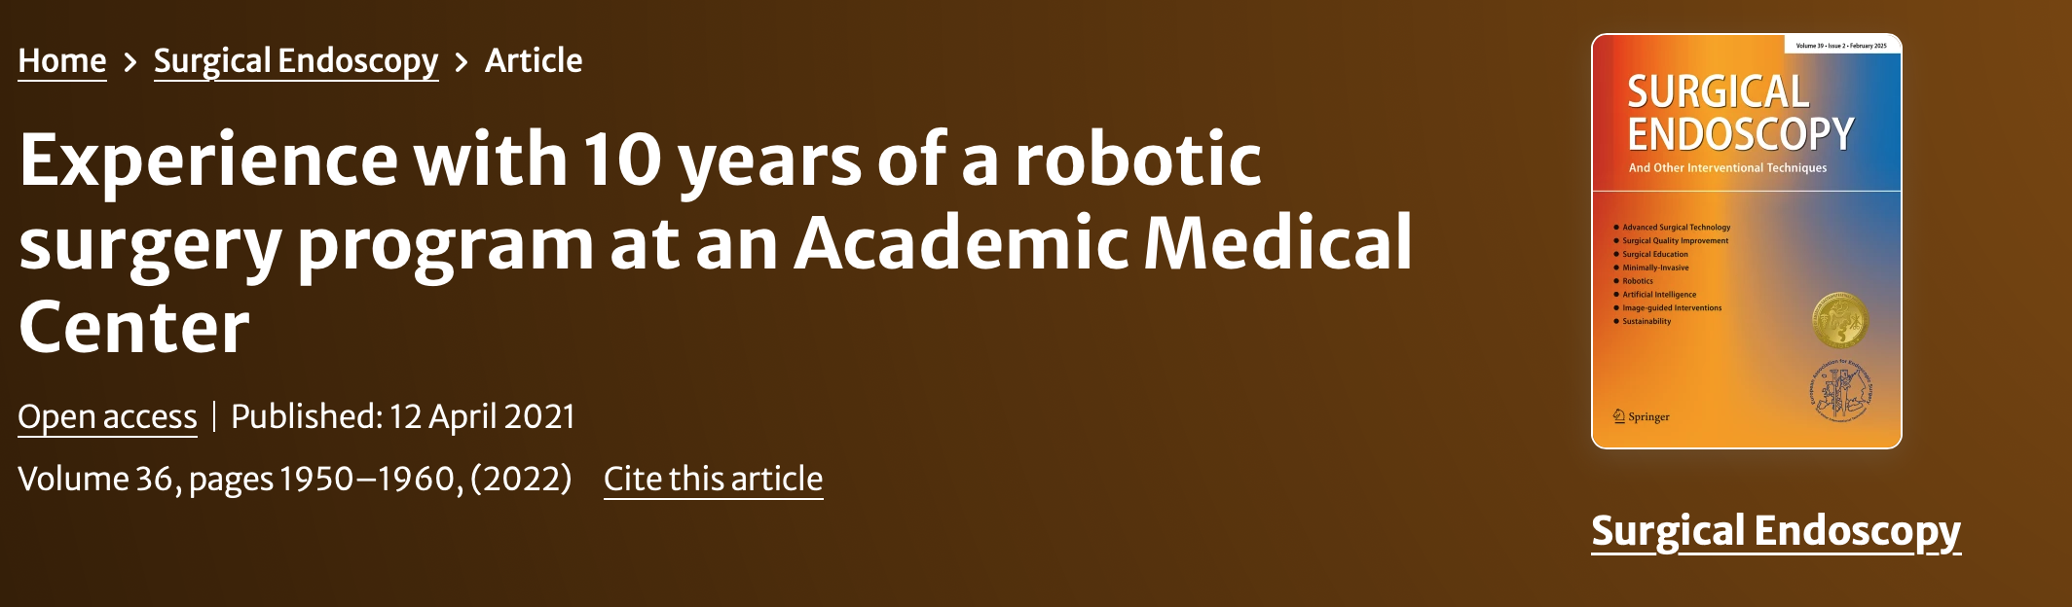
Financial Reality check
Capital Investment
  Initial cost 10-20 Cr
  Annual Maintenance – 1 Cr
  Per Case cost – 1.2-2 Lakhs
  Overall System Cost per Case – ~ 10 Lakhs

Slide 11
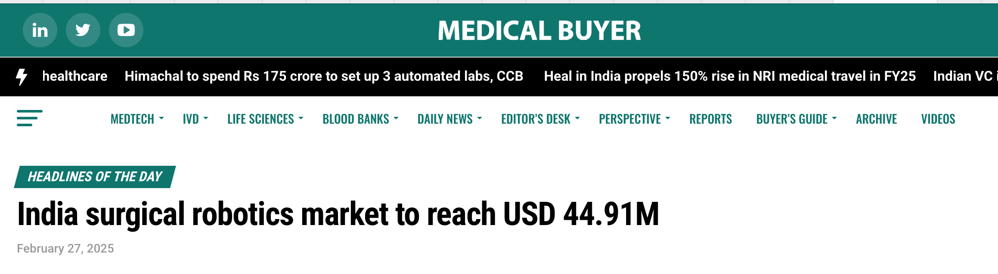
Volume requirement Viability
Approx – 100 cases for sustainability
Multi-specialty Strategy: Pooling cases across departments essential for ROI
Market Reality: 60,000 robotic surgeries performed annually across India

Slide 12
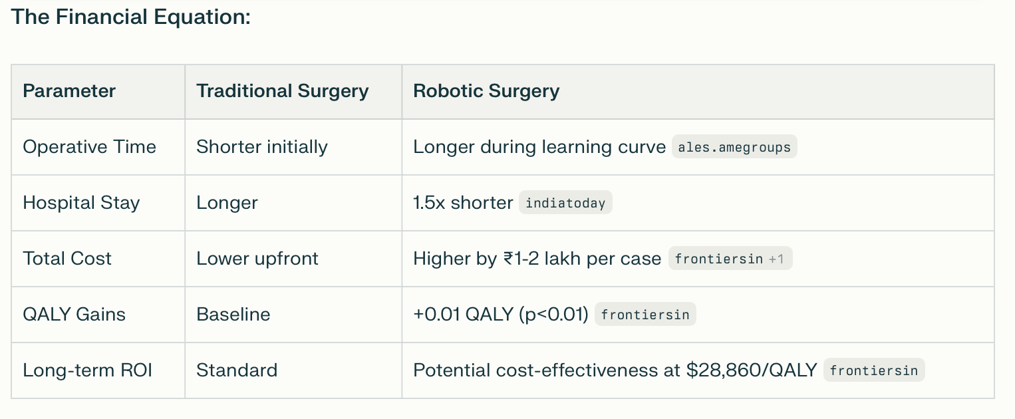
Financial equation

Slide 13
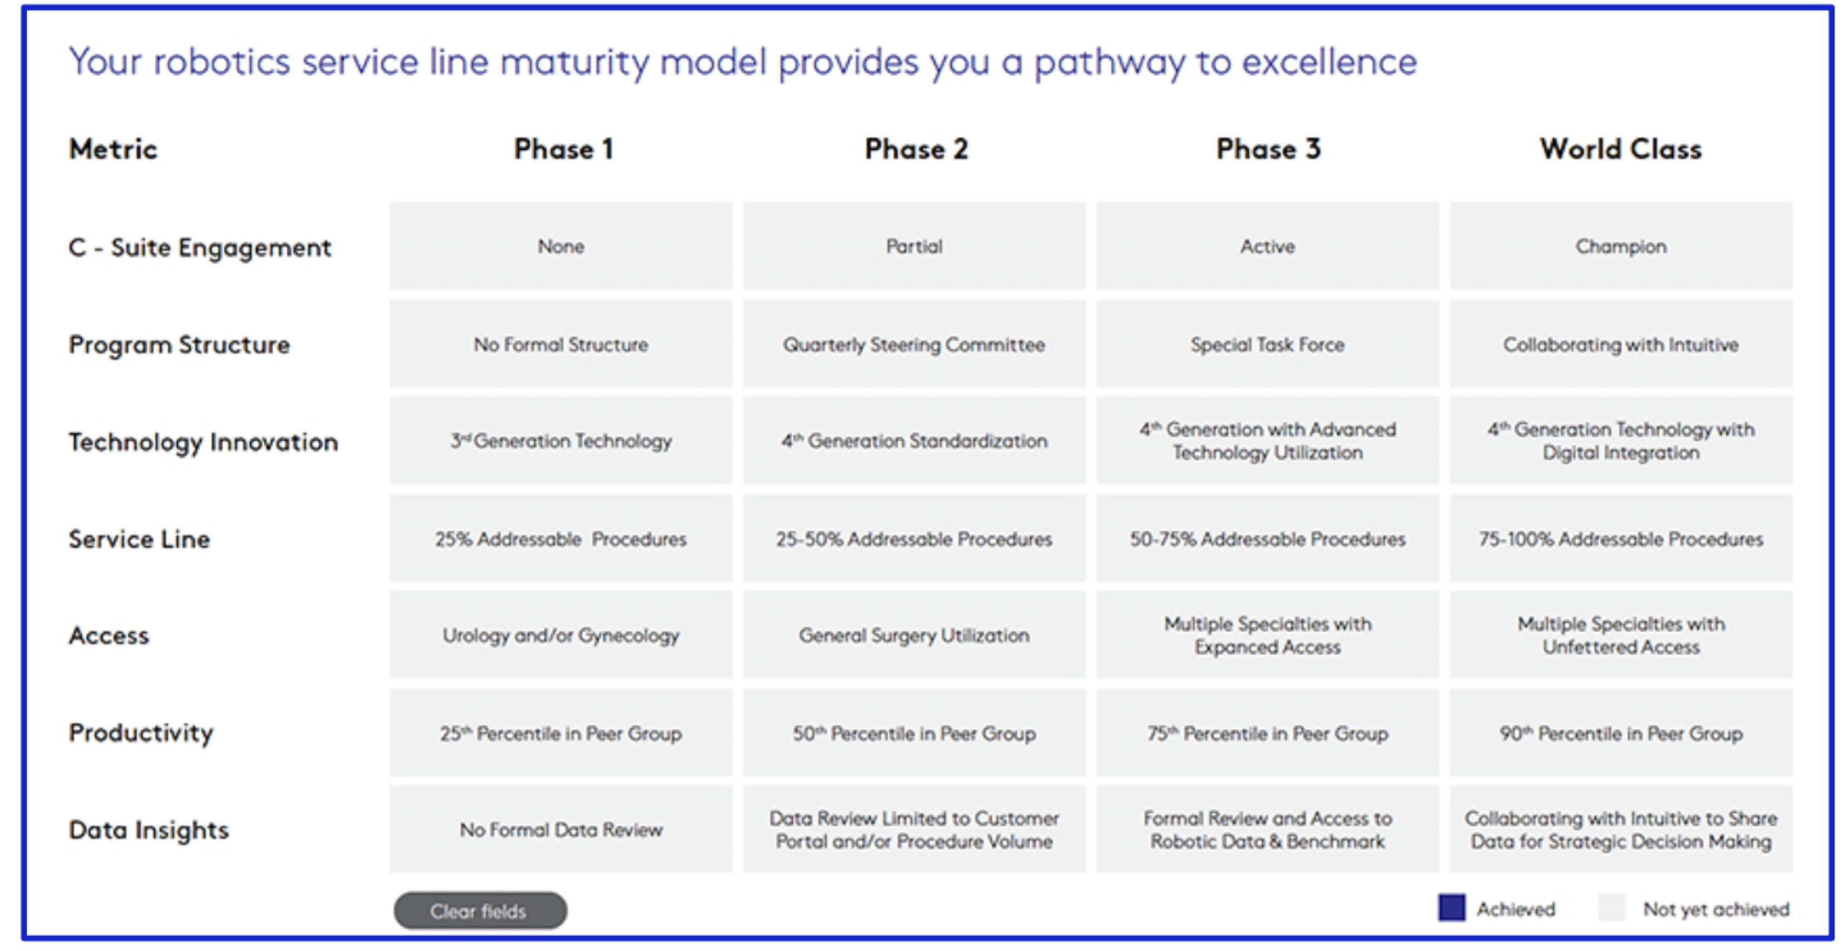

Slide 14
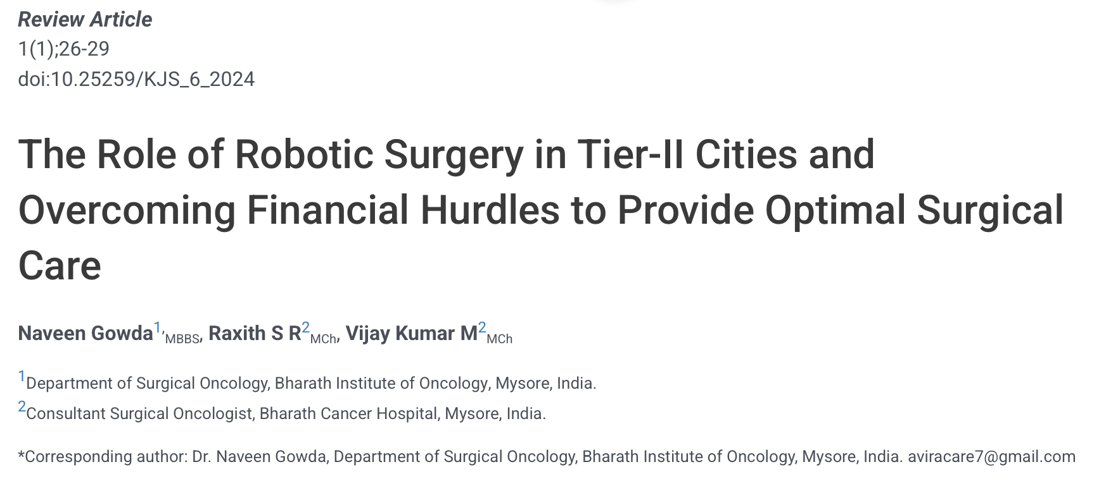
The Over-Investment Concerns
Under-utilization Risk: Systems used <50 cases/year show poor ROI
Tier-II City Challenges: Slower return on investment, limited patient volume
Insurance Gaps: Limited coverage, many procedures considered "elective"

Slide 15
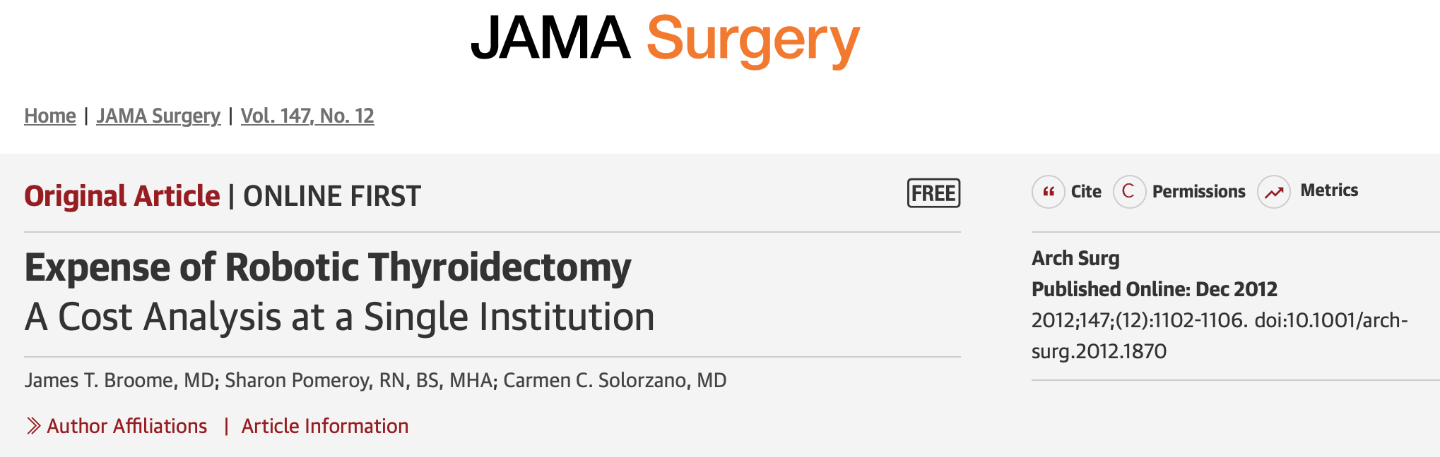
The Over-Investment Concerns
The relative costs was $ 3000 (Approx -2 lakhs)
217% increased cost
The mean operative times were 113 minutes for ST vs 137 minutes for RT.
Technology Obsolescence: 5-year depreciation cycle, constant upgrades required

Slide 16
Quantify the Impact (QTI)
Clinical outcomes mapped to Economic Outcomes and quantified in Rupees Value as revenue opportunity for the Hospital
Dr. Anand Subash
Department of Head and Neck Oncology
8th September 2025

Slide 17
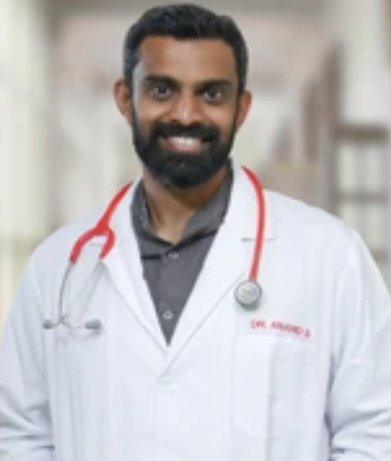
Single surgeon unpublished experience – clinical outcomes
Dr. Anand Subash: Surgeon's own da Vinci, and Open data
Neck Dissection
Surgeon Headshot if available
Chance of Re-Exploration
(%)
Direct Cost Implication Rs. 13,50,000/- vs Open
At HCG, for Surgical Re-Exploration Hospital absorbs 60% Cost and Patient Absorbs 40% Cost
Estimated Cost Saved by preventing ‘Re-Exploration’:
Rs. 8,10,000
Open (n=100)
Da Vinci RAS (n=100)
Rs. 1,50,000/- Incurred per Re-Exploration

Slide 18
Single surgeon unpublished experience – clinical outcomes
Dr. Anand Subash: Surgeon's own da Vinci, and Open data
Neck Dissection
Surgeon Headshot if available
SSI
(%)
Estimated Cost Saved by preventing ‘SSI’:
Rs. 50,000/- vs Open
Open (n=100)
Da Vinci RAS (n=100)
Rs. 10,000 Incurred per SSI Management

Slide 19
Single surgeon unpublished experience – clinical outcomes
Dr. Anand Subash: Surgeon's own da Vinci, and Open data
Neck Dissection
Surgeon Headshot if available
Length of Stay (Days)
Recovery Time
(Days)
Open (n=100)
Da Vinci RAS (n=100)
Complete Recovery post discharge

Slide 20
Single surgeon unpublished experience – clinical outcomes
Dr. Anand Subash: Surgeon's own da Vinci, and Open data
Neck Dissection
Surgeon Headshot if available
Rate of Drop Out after surgery (%)
Estimated Revenue made by preventing “Patient Drop Out”:
Rs. 24,00,000 v/s Open
These Adjuvant therapies are mainly Radiation and Chemotherapy
Open (n=100)
Da Vinci RAS (n=100)
Rs. 4,00,000/- Incurred per Adjuvant Therapy

Slide 21
Single surgeon unpublished experience – clinical outcomes
Dr. Anand Subash: Surgeon's own da Vinci, and Open data
Neck Dissection
Surgeon Headshot if available
SI. No. | Clinical Outcomes | Cost Saving
1 | Chance of Re-Exploration | Rs. 8,10,000
2 | SSI | Rs. 50,000
Total Cost Saving in Robotic Vs Open is Rs. 8,60,000/- Per 100 procedures
SI. No. | Outcomes | Revenue Opportunity
1 | LOS | Rs. 45,00,000
2 | Rate of Drop Out | Rs. 24,00,000
Total Revenue made in Robotic Vs Open is Rs. 69,00,000/- Per 100 procedures

Slide 22
Single surgeon unpublished experience – Economic Impact
Estimated incremental revenue opportunity resulting from shortened LOS with da Vinci vs. Open surgery
Dr. Anand Subash
Neck Dissesction
1
2
3
4
5
Length of Stay (Days)
Average Reduced LOS per Patient
Number of Patients
Treated per year (Est.)
Total Hospital Bed days saved per year (Est.)
Average Bed Occupancy Rate (Est.)
Total occupiable Hospital Bed days saved per year
Surgeon Headshot if available
1
100
=
100
75%
=
75
6
INR
Open (n=100)
***ARPOB per day for Hospital
Da Vinci RAS (n=100)
60,00,000
7
INR 45,00,000/-
Estimated Incremental Revenue Opportunity per year

Slide 23
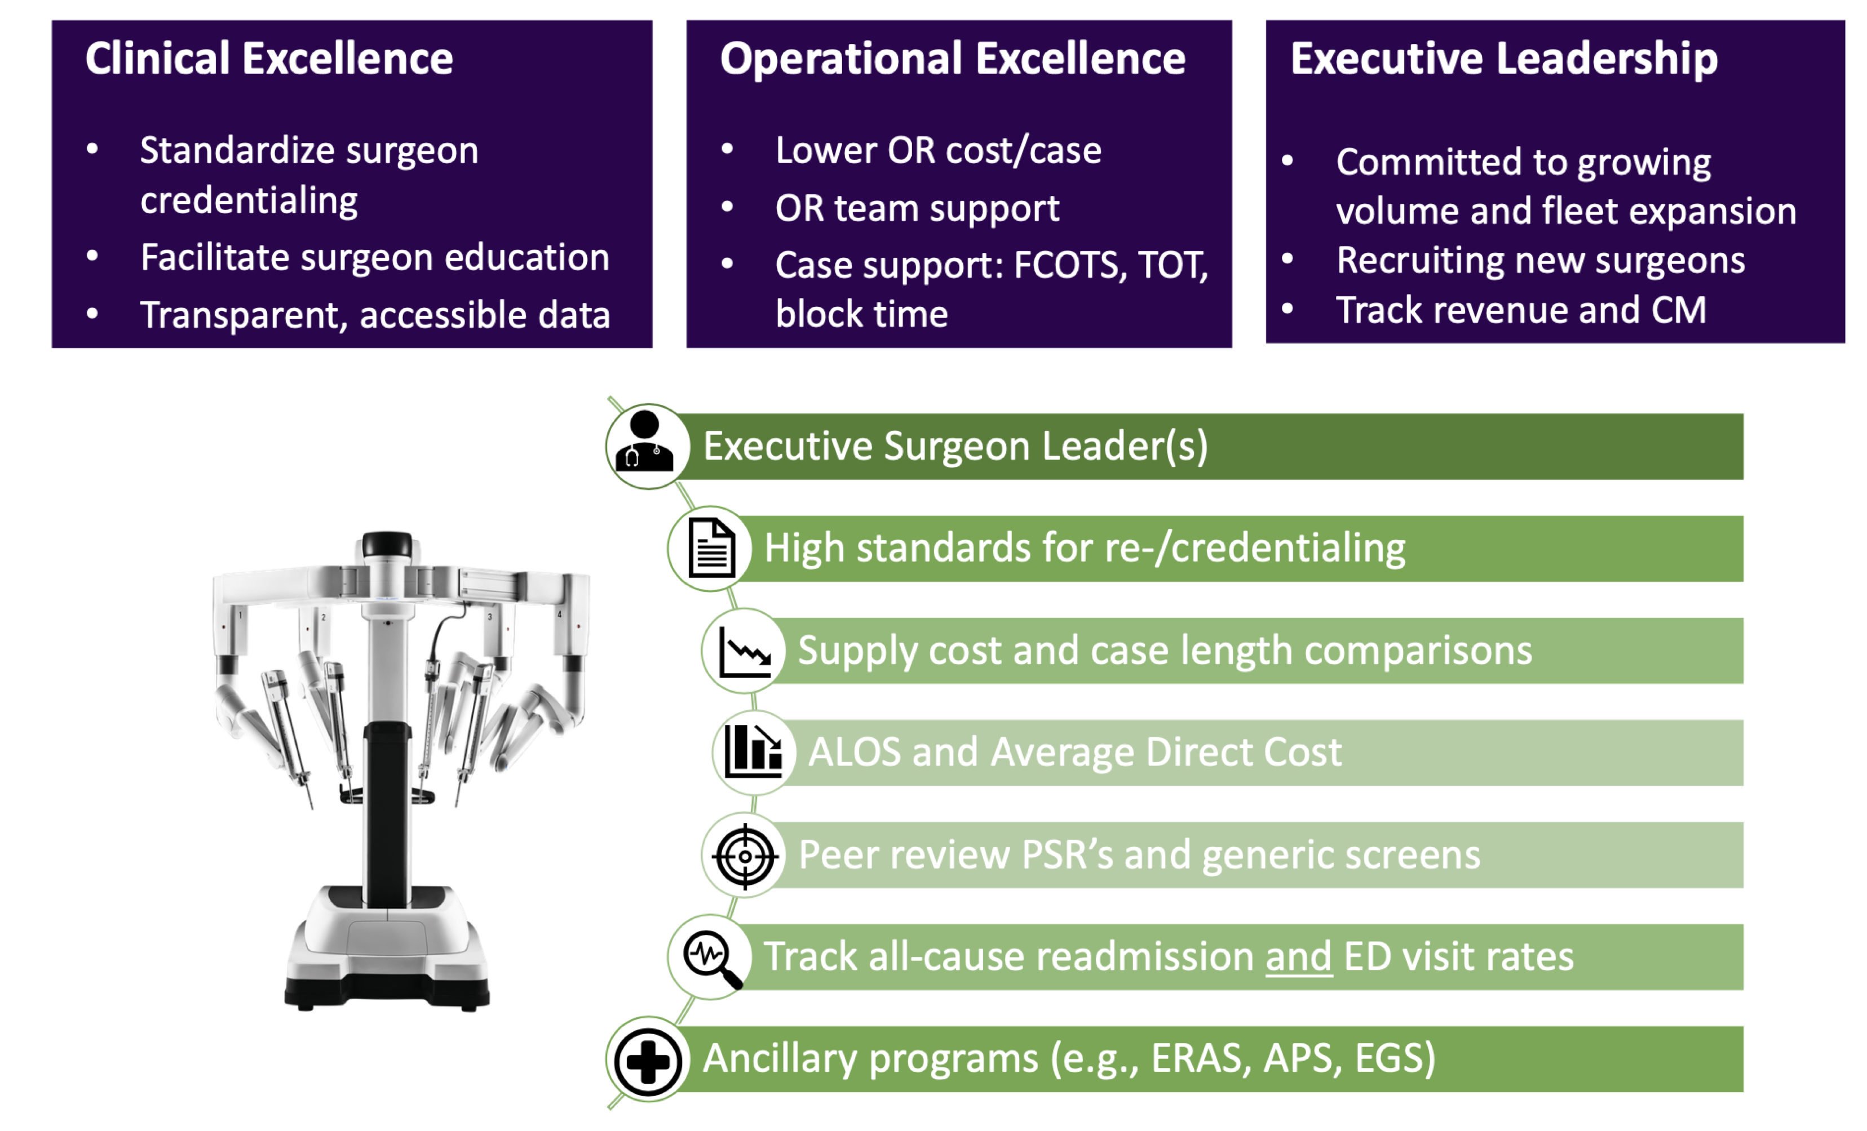
ROBOTIC STEERING COMITTEE

Slide 24
The Over-Investment Trap
Ego-driven Adoption: Technology for prestige vs. patient benefit
Insufficient Volume Planning: <50 cases/year projections
Inadequate Training Investment: Rushing past learning curves
Poor Case Selection: Using robotics where conventional surgery suffices

Slide 25
Emerging trends & future perspectives
Cost Reduction: New systems (Hugo, Versius) targeting affordability
AI Integration: Enhanced precision, reduced learning curves
Modular Systems: Scalable solutions for mid-tier hospitals
Indian Innovation: Domestic robotic systems in development

Slide 26
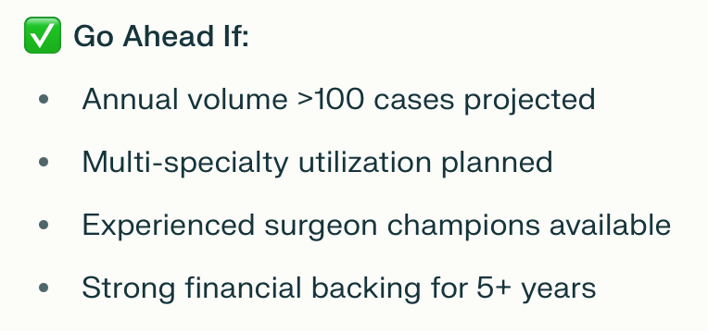
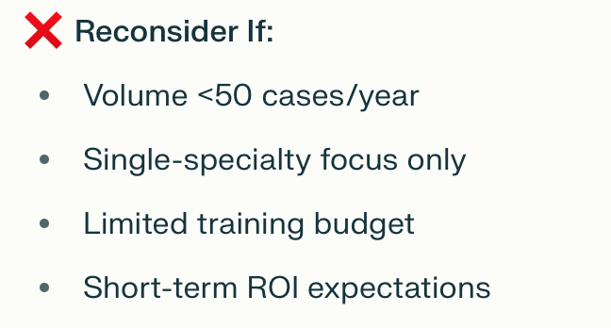
DECISION FRAMEWORK
EXCELLENCE v/s OVERINVESTIMENT

Slide 27
verdict
Excellence in Precision: Real, measurable benefits in appropriate settings
Over-Investment Risk: Significant without proper planning and volume
The Sweet Spot: High-volume, multi-specialty programs with committed leadership
Indian Reality: Selective adoption based on local factors and sustainable planning

Slide 28
Thank You!

